Slide 1
Xamarin.Forms & Cognitive Services
Winston Gubantes
Senior .Net Consultant / Xamarin Developer
Gluon Consulting

Slide 2

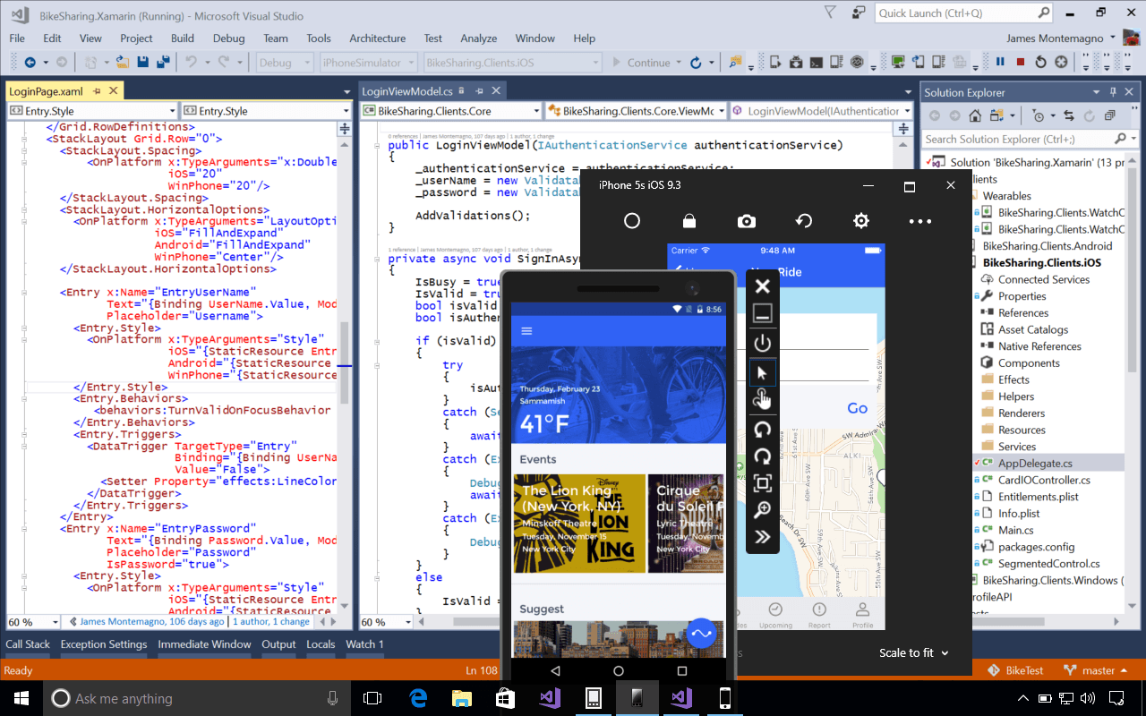
Xamarin.Forms
Anything you can do in Objective-C, Swift or Java, you can do in C#.

Slide 3
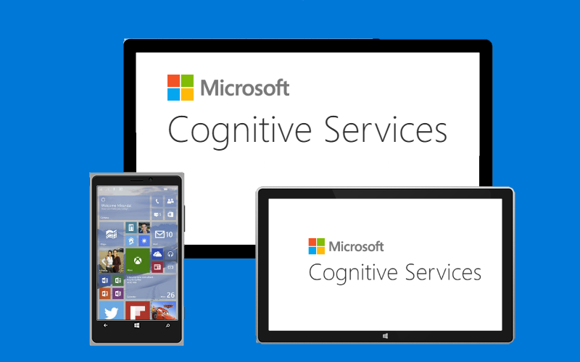
Cognitive Services Apis
Tap into the power of machine learning with easy-to-use REST APIs.

Slide 4
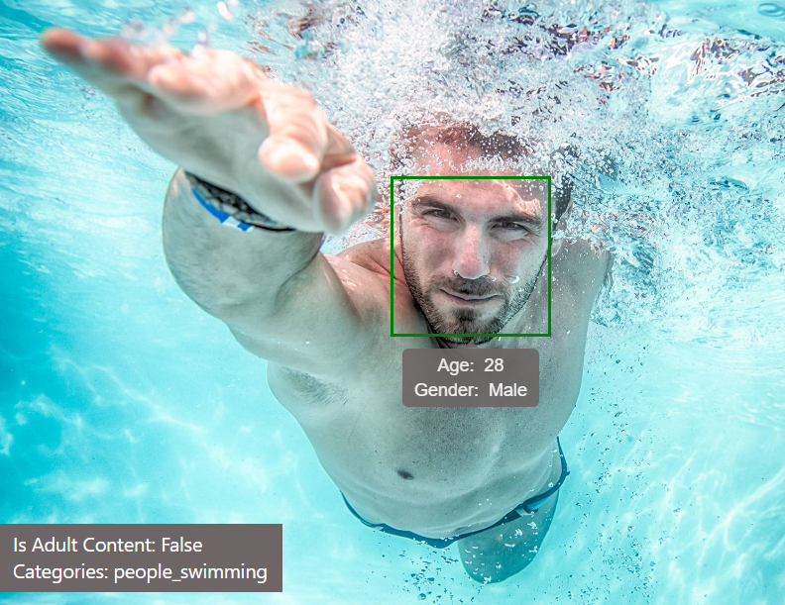
Computer Vision Api
This feature returns information about visual content found in an image.

Slide 5
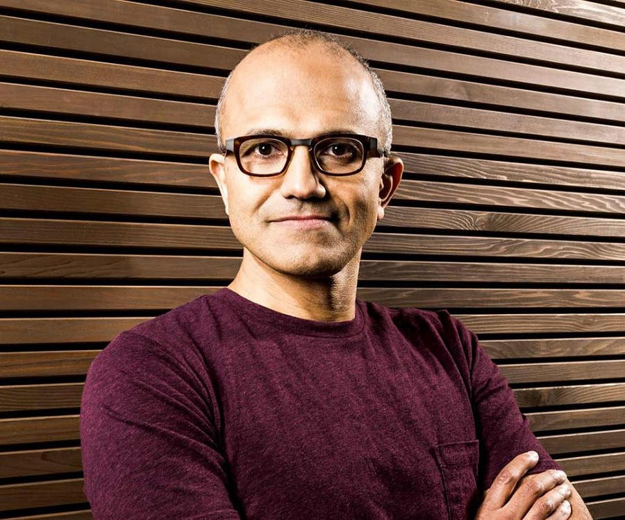
Computer Vision Api
Recognizes 200K celebrities from business, politics, sports and entertainment around the World.

Slide 6

Computer Vision Api
Optical Character Recognition (OCR) detects text in an image and extracts the recognized words into a machine-readable character stream.

Slide 7

Language Understanding Intelligent Service
One of the key problems in human-computer interactions is the ability of the computer to understand what a person wants.

Slide 8

Language Understanding Intelligent Service
Designed to provide you with an easy way to create models, which allow your applications to understand user commands.

Slide 9

Language Understanding Intelligent Service
For example, you might say "Book me a ticket to Paris" in which case there is the intention to "BookTicket" while "Paris" is the location entity.

Slide 10
Demo

Slide 11
Steps – LUIS application creation
Create language understanding app and models.
We also need a smart chatbot C# project with Microsoft Bot Framework.
Register your bot in https://dev.botframework.com
Setup a DirectLine
Create a Xamarin.Forms projects to connect with DirectLine
Complete steps click here

Slide 12
Resources
https://github.com/winstongubantes/Xamarin-Fiesta
Wrap Up
Mobile Apps creation has made simple using Visual Studio with Xamarin
With Cognitive Services enable us to create smarter apps
Integration of your Xamarin Apps and Cognitive Service is seamless.

Slide 13

© 2014 Microsoft Corporation. All rights reserved. Microsoft, Windows, Windows Vista and other product names are or may be registered trademarks and/or trademarks in the U.S. and/or other countries.
The information herein is for informational purposes only and represents the current view of Microsoft Corporation as of the date of this presentation. Because Microsoft must respond to changing market conditions, it should not be interpreted to be a commitment on the part of Microsoft, and Microsoft cannot guarantee the accuracy of any information provided after the date of this presentation. MICROSOFT MAKES NO WARRANTIES, EXPRESS, IMPLIED OR STATUTORY, AS TO THE INFORMATION IN THIS PRESENTATION.

